Slide 1
I’m the Boss of my Hearing Loss!!
By: EG

Slide 2
My name is elias!
My favorite color is GREEN!
I am 6 years old.
My favorite superhero is the FLASH!
My favorite sport is soccer!

Slide 3
I have a hearing loss. That means I can’t hear that well.

Slide 4
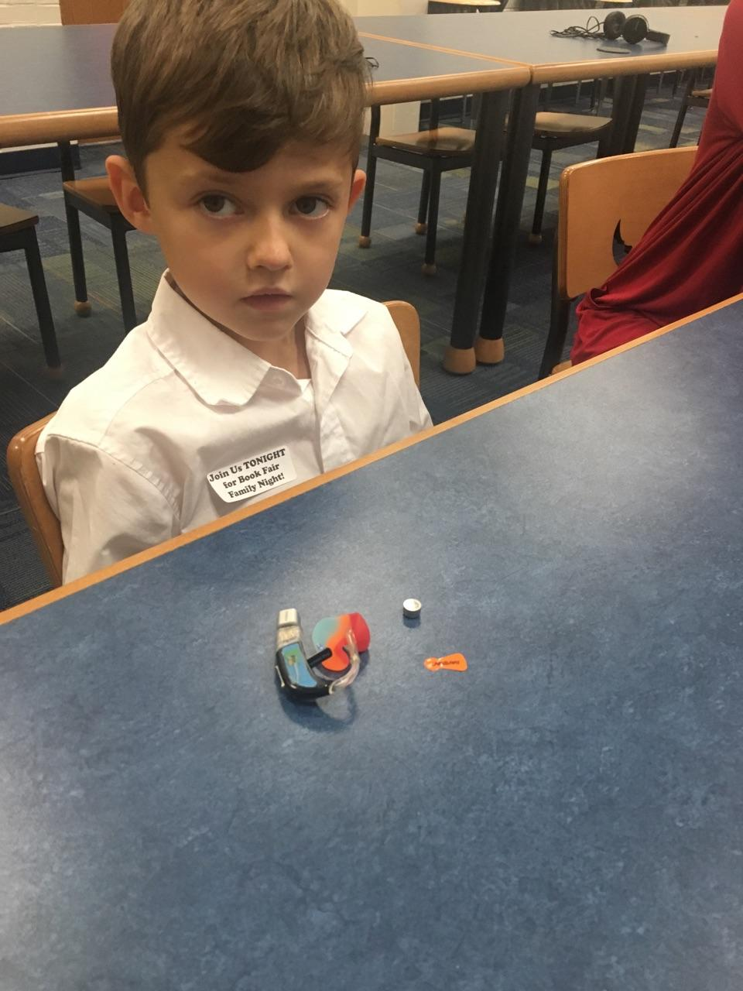
Some people are deaf and some people are hard of hearing.

Slide 5
Deaf means you can’t hear at all. People who are deaf may use sign language to communicate.

Slide 6
Hard of Hearing means You can hear a little bit. I am Hard of Hearing.

Slide 7
I have trouble hearing In my left ear. So I wear one hearing aid.

Slide 8
I have No hearing loss In my right ear. So I wear only one wear a hearing aid.

Slide 9
My hearing aid helps me hear better. it make sounds louder.

Slide 10
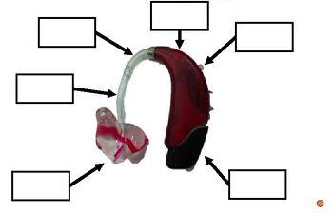
This is what my hearing aid looks like. It has many parts.
Microphone
Hook
Case
Tube
Battery
Case
Earmold
Receivers

Slide 11
Sometimes my Hearing Aid does not work. That means I need to _____. I tell ____ when my Battery dies. I take my Hearing aid off and _______

Slide 12
I throw the old battery _______

Slide 13
I take a new battery from the pack and ________

Slide 14
After I peel the paper, I wait for ___ seconds before I put the battery in the Hearing aid.

Slide 15
I also use A _____ to help me hear the ______ better.

Slide 16
To use the ____, each morning I attach the ____ to the bottom of my hearing aids.

Slide 17
We unplug the charging ___, ____, and give it to _______.

Slide 18
Sometimes if the teacher doesn’t wear it right, I tell her To:
Move it up – flip it over - unmute it
Closer to her mouth

Slide 19
At the end of the day, I take off the _____, Turn off the ____, and plug it in to _______.

Slide 20
Sometimes it’s difficult to hear what people say. When people cover their mouths, I say “______________!”

Slide 21
When people whisper, I say “_______________!”

Slide 22
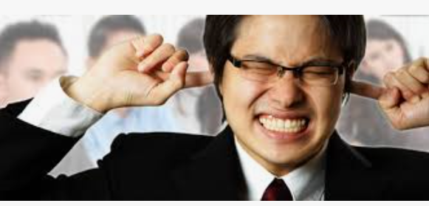
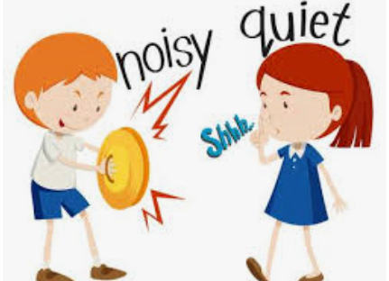
When it’s too noisy, I say “_________________!”

Slide 23
I hear better with my________ side. I like when people sit near my _____.

Slide 24
I do not like when people sit near my ________ ear.

Slide 25
Because I have trouble hearing, I need to sit_______ the teacher.

Slide 26
It is not good to sit far away because __________________!

Slide 27
When the teacher writes on the board, It helps when ____________ when she is talking and writing at the same time.

Slide 28
It is hard to understand the teacher when she doesn’t ______ When she is talking and writing at the same time.

Slide 29
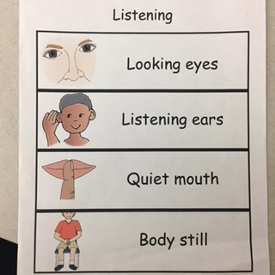
When The Teacher is talking, I need to be a good listener. I listen with my ____, with my ____, with a _____ and a______.

Slide 30
Sometimes, even when I am being a good listener, I don’t hear things. I ask the teacher: “____________ please?”

Slide 31
I am not the only student in the school with Hearing Aids. My friend ____ has a hearing aid too.

Slide 32
If it is too noisy in the hallway and the classroom door is open, I ask my teacher if I can __________.

Slide 33
I’m the boss of my hearing loss!
I take care of my hearing aids.
I take care of my FM.
I help the teacher remember to use the FM.
I let other people know when I can’t hear.
That’s why I am the
BOSS OF MY HEARING LOSS!

