Slide 1
Zootopia

Slide 2
Explore Zootopia and catch the criminals!

Slide 3
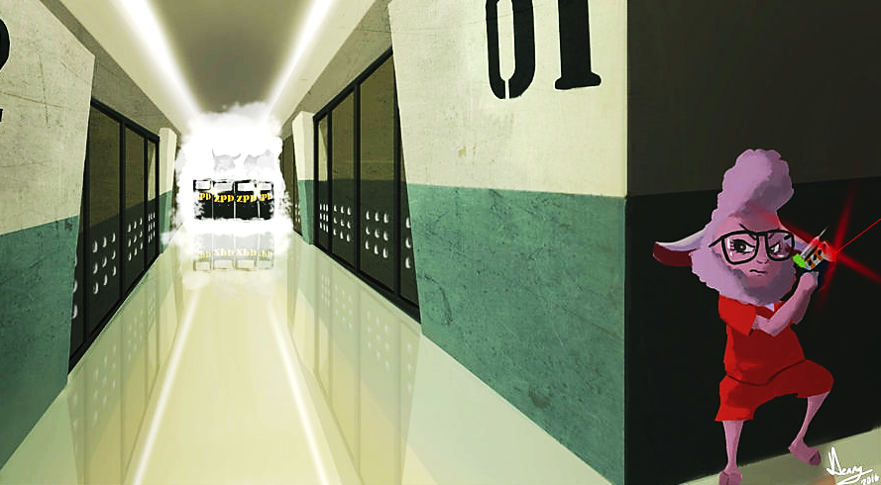
WANTED
B
e
l
l
w
e
t
h
e
r
s
n
E
p
r
i
s
c
a
e
d
p
o
By the ZPD

Slide 4
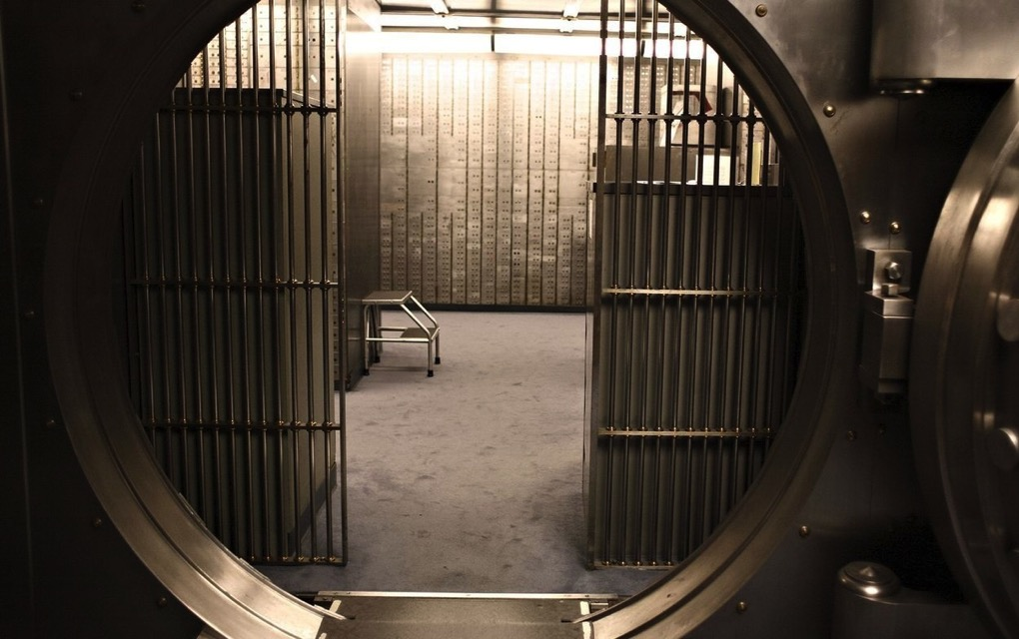
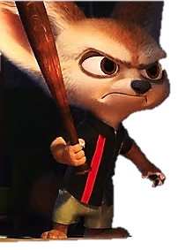
WANTED
F
i
n
n
i
c
k
o
b
a
a
R
b
e
d
b
n
k
By the ZPD

Slide 5
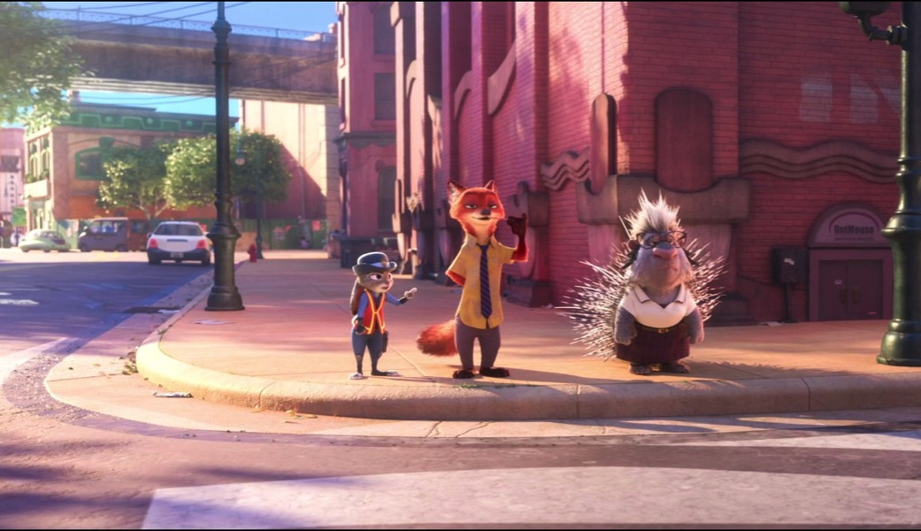
WANTED
F
l
a
s
h
l
t
o
e
r
S
a
c
a
By the ZPD

Slide 6
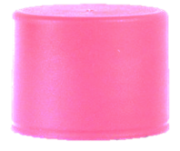
+1
+5
Minus points
trade
Steal

Slide 7
Let’s go!

Slide 8
Tundratown
The Ear
B
D
A
C
E
G
I
F
H
J
Notes:
CLICK THE ARROW IN THE BOTTOM RIGHT CORNER TO CONTINUE TO THE NEXT SET OF QUESTIONS

Slide 9
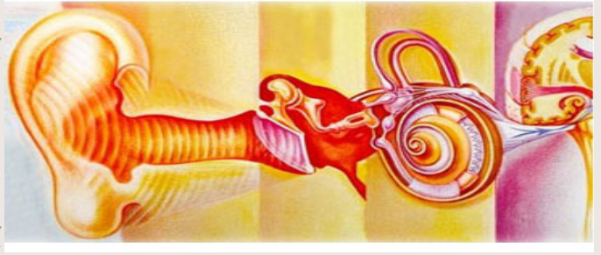
What is this part of the ear called
Ear canal

Slide 10
+5
+5
Notes:
Click Judy to go to the home page

Slide 11
What is this part of the ear called
Pinna

Slide 12
+10
+10
Notes:
Click Judy to go to the home page

Slide 13
What is this part of the ear called
Ear drum

Slide 14
+1
+1
Notes:
Click Judy to go to the home page

Slide 15
What is this part of the ear called
Three bones

Slide 16
+3
+3
Notes:
Click Judy to go to the home page

Slide 17
What is this section of
the ear called
Outer ear

Slide 18
Choose!
Choose!

Slide 19
5
5
Steal
Steal
Notes:
Click Judy to go to the home page

Slide 20
5
5
Steal
Steal
Notes:
Click Judy to go to the home page

Slide 21
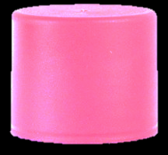
-5
-5
Notes:
Click Nick to go to the home page

Slide 22
What is this part of the ear called
cochlea

Slide 23
Choose!
Choose!
L eft
Right

Slide 24
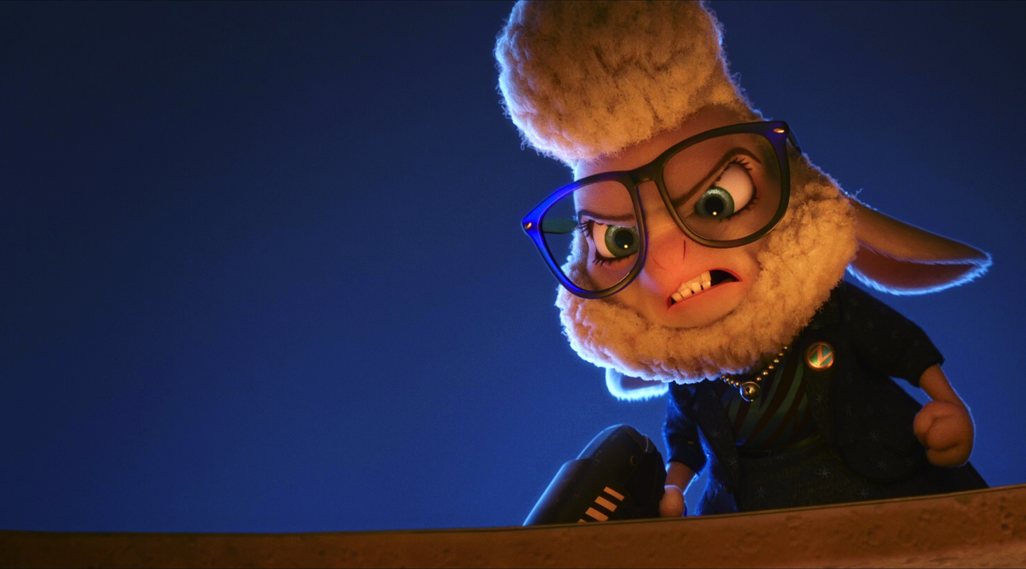
It’s Bellwether!
It’s
Bellwether!

Slide 25
WANTED
+15
+15
By the ZPD
Bellwether
Notes:
Click Nick & Judy to go to the home page

Slide 26
What is this part of the ear called
Auditory nerve

Slide 27
+5
+5
Notes:
Click Judy to go to the home page

Slide 28
What is inside the cochlea
Hair cells

Slide 29
+2
+2
Notes:
Click Judy to go to the home page

Slide 30
What is this section of
the ear called
Inner ear

Slide 31
Choose!
Choose!
L eft
Right

Slide 32
Trade
Trade
Notes:
Click Judy to go to the home page

Slide 33
+1
+1
Notes:
Click Judy to go to the home page

Slide 34
What is this section of
the ear called
Middle ear

Slide 35
+4
+4
Notes:
Click Judy to go to the home page

Slide 36
Rainforest District
Hearing Aid
B
D
A
C
E
G
I
F
H
J
Notes:
CLICK THE ARROW IN THE BOTTOM RIGHT CORNER TO CONTINUE TO THE NEXT SET OF QUESTIONS

Slide 37
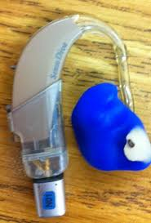
What is this part called
Receivers

Slide 38
Choose!
Choose!

Slide 39
Rock paper scissors...
Rock paper scissors...
Winner steal
Winner steal
5
5
Notes:
Click Judy to go to the home page

Slide 40
-5
-5
Notes:
Click Nick to go to the home page

Slide 41
Rock paper scissors...
Rock paper scissors...
Winner steal
Winner steal
5
5
Notes:
Click Judy to go to the home page

Slide 42
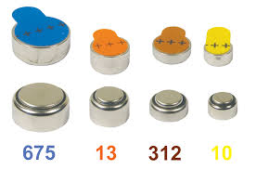
How long should you wait
to put your batteries in
Two minutes

Slide 43
Choose!
Choose!
L eft
Right

Slide 44
It’s Finnick!
It’s Finnick!

Slide 45
WANTED
+15
+15
By the ZPD
Finnick
Notes:
Click Nick & Judy to go to the home page

Slide 46
What is this part called
tube

Slide 47
+5
+5
Notes:
Click Judy to go to the home page

Slide 48
What is this part called
Battery door

Slide 49
6
6
Steal
Steal
Notes:
Click Judy to go to the home page

Slide 50
What is this part called
Microphones

Slide 51
+3
+3
Notes:
Click Judy to go to the home page

Slide 52
What is this part called
Battery

Slide 53
+2
+2
Notes:
Click Judy to go to the home page

Slide 54
What is this part called
Case

Slide 55
+4
+4
Notes:
Click Judy to go to the home page

Slide 56
What is this part called
Ear mold

Slide 57
+5
+5
Notes:
Click Judy to go to the home page

Slide 58
What is this part called
Hook

Slide 59
+8
+8
Notes:
Click Judy to go to the home page

Slide 60
What do you do if your hearing aid is not working
Change battery or tell the teacher

Slide 61
Choose!
Choose!
L eft
Right

Slide 62
+10
+10
Notes:
Click Judy to go to the home page

Slide 63
Trade
Trade
Notes:
Click Judy to go to the home page

Slide 64
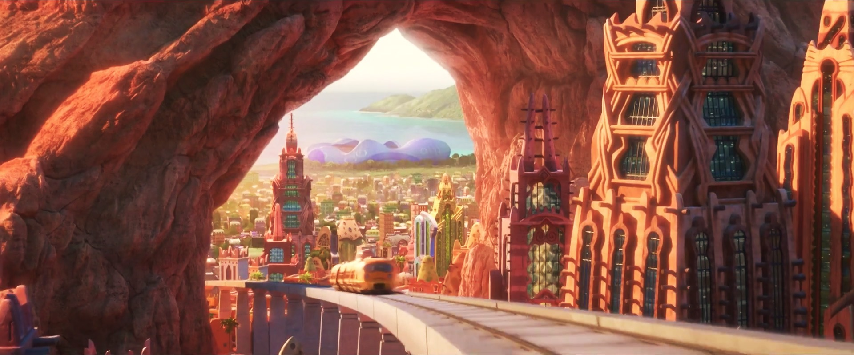
Sahara Square
Self Advocacy o
B
D
A
C
E
G
I
F
H
J
Notes:
CLICK THE ARROW IN THE BOTTOM RIGHT CORNER TO GO TO THE ENDING SLIDE

Slide 65
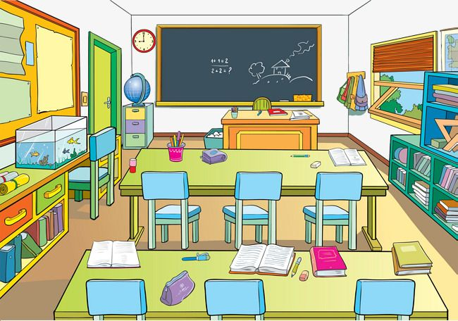
What is preferential seating
Sitting close to the teacher
In front and away from noise

Slide 66
+3
+3
Notes:
Click Judy to go to the home page

Slide 67
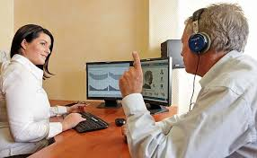
Who tests your hearing
Audiologist

Slide 68
Choose!
Choose!
L eft
Right

Slide 69
Rock paper scissors...
Rock paper scissors...
Winner steal
Winner steal
2
2
Notes:
Click Judy to go to the home page

Slide 70
Trade
Trade
Notes:
Click Judy to go to the home page

Slide 71
What type of hearing loss
do you have
Conductive

Slide 72
+2
+2
Notes:
Click Judy to go to the home page

Slide 73
What would you do if you didn’t hear the directions
Ask teacher to repeat or ask friend

Slide 74
+4
+4
Notes:
Click Judy to go to the home page

Slide 75
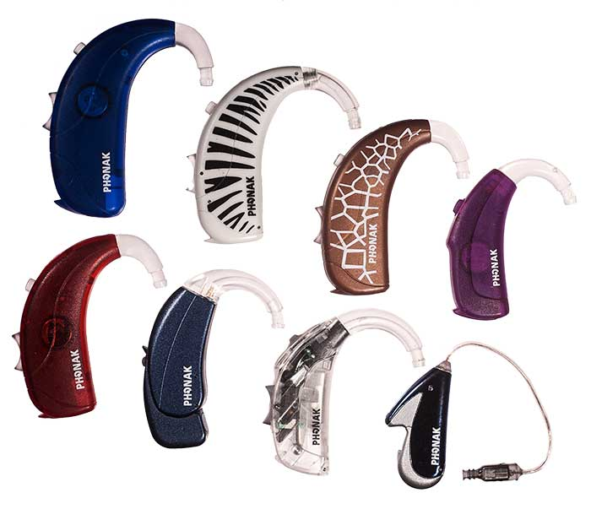
What would you do if you left your hearing aid at home
Call home see if they can drop it off

Slide 76
Go inside?
Go inside?
Yes
No

Slide 77
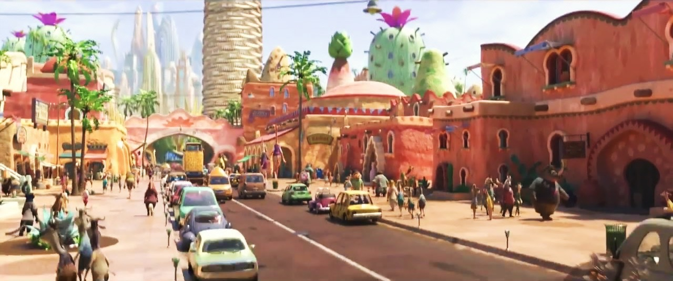
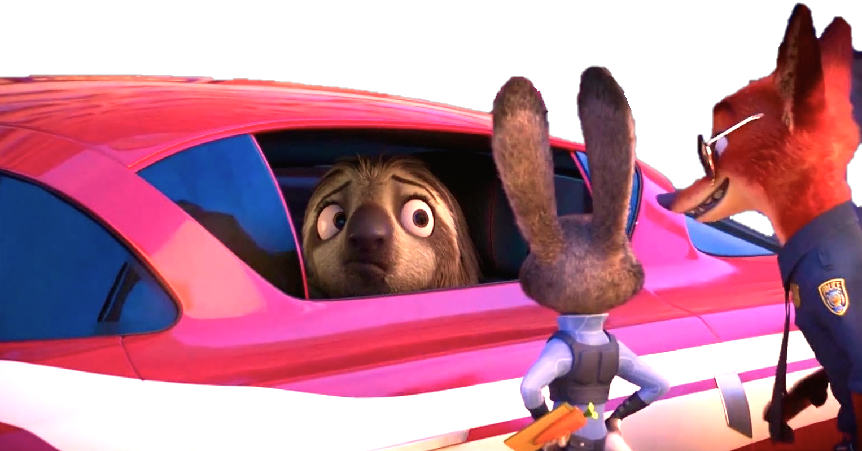
It’s Flash!
It’s
Flash!

Slide 78
WANTED
+15
+15
By the ZPD
Flash
Notes:
Click Nick & Judy to go to the home page

Slide 79
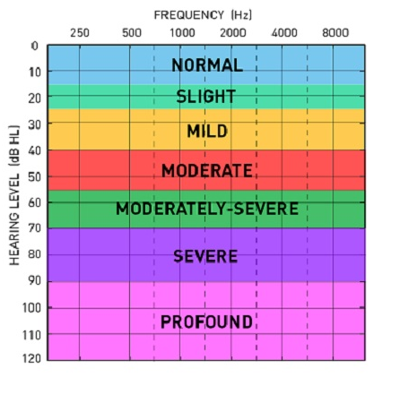
What is your hearing levels
Normal in one ear
mild to sever in another

Slide 80
+5
+5
Notes:
Click Judy to go to the home page

Slide 81
What should you do if your hearing aid is not working
Change battery or tell teacher

Slide 82
+6
+6
Notes:
Click Judy to go to the home page

Slide 83
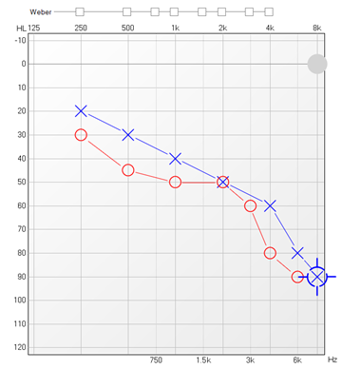
How do you change the battery of your hearing aid
Open battery door ,take and throw out old battery, wait two mins to put new one in ,
and then youre done

Slide 84
Choose!
Choose!

Slide 85
+7
+7
Notes:
Click Judy to go to the home page

Slide 86
+10
+10
Notes:
Click Judy to go to the home page

Slide 87
-5
-5
Notes:
Click Nick to go to the home page

Slide 88
What would you do if your classmate is making noise and you cant hear the teacher
Ask them to stop and
ask teacher to repeat what they say

Slide 89
+8
+8
Notes:
Click Judy to go to the home page

Slide 90
How often should you see the audiologist
Once a year

Slide 91
+5
+5
Notes:
Click Judy to go to the home page

Slide 92
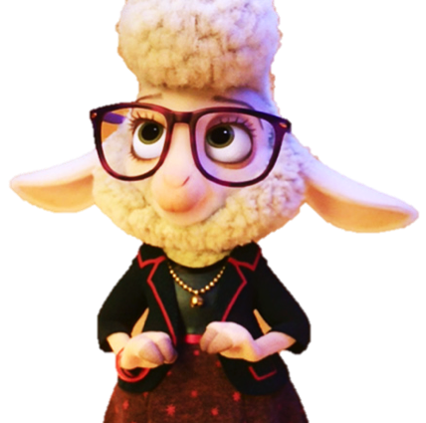
WANTED
WANTED
WANTED
WANTED
WANTED
By the ZPD
WANTED
By the ZPD
By the ZPD
By the ZPD
By the ZPD
By the ZPD
Bellwether
Bellwether
Flash
Flash
Finnick
Finnick

Slide 93
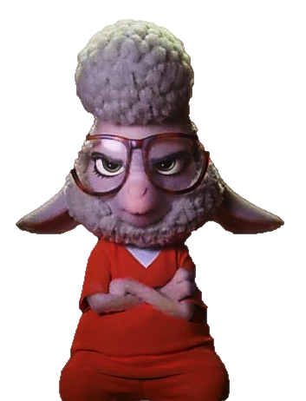
Good job!
Bellwether
Flash
Finnick

